Slide 1
Piano Simulator
Darryn Arrington

Slide 2
Specifications
What was needed
Simulates a very simple piano.
Uses two octaves.
Program displays the keys of the piano
The user presses a key (a-g) and then the program generates the respective sound for a certain time period.
If (A-G) is pressed the sound of higher octave will be generated.

Slide 3
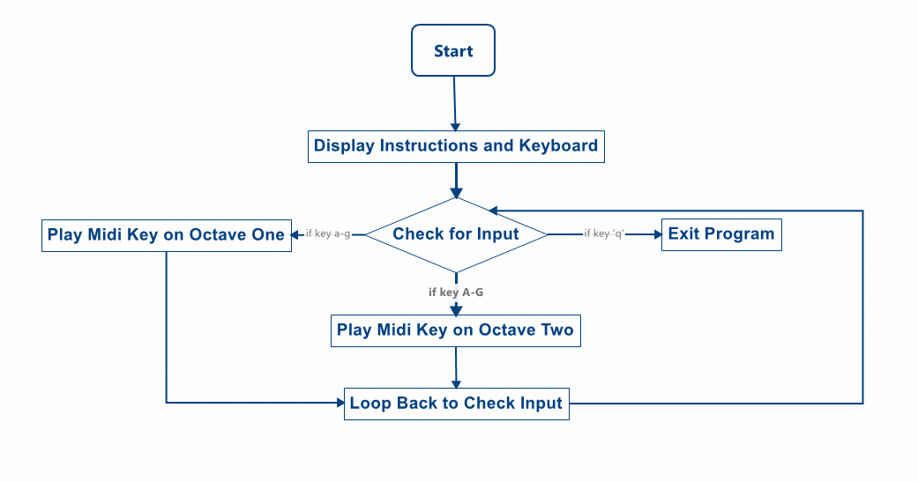
Program Flowchart

Slide 4
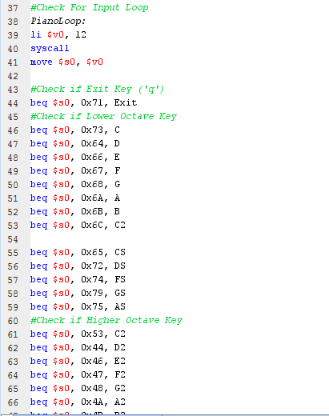
The Piano Loop
Comprises the main part of the program.
Made up of a series of beq statements that checks what key the user has pressed.
Each statements causes the program to jump to a branch that plays a midi key note.
The program then jumps back to the beginning of the loop and repeats the process.
Pressing the ‘q’ key activates the exit condition.

Slide 5
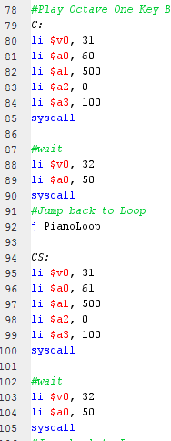
Key Branches
These branches are responsible for loading values into the registers that are needed for MIDI output.
In particular, the $a0 register is the most important because it determines what pitch the note will be.
The $a1 register determines the duration of the note.
The $a2 register determines the type of instrument (instrument 0 is a standard piano).
The $a4 register determines the volume of the note.

Slide 6
Problems and Limitations
The program cannot play more than one note at a time. This means chords cannot be played.
This limitation is a result of how the MARS environment implements syscall for MIDI output.
Playing notes to fast could cause the program to distort the sound of the keys.

Slide 7

Demonstration Time

